Slide 1
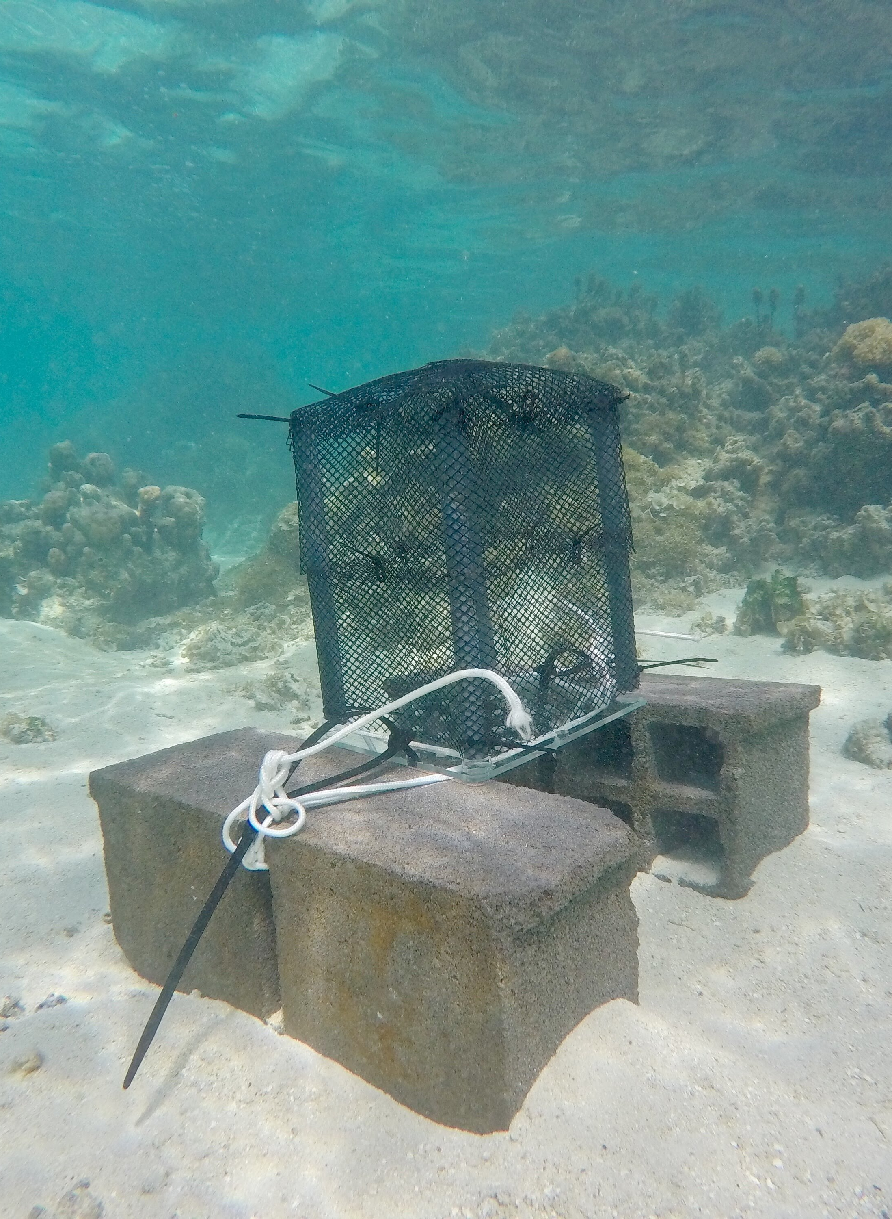
Shaded or unshaded Lexan
PVC
Cinderblocks
Coral Plug
Lexan
O-ring

